Slide 1


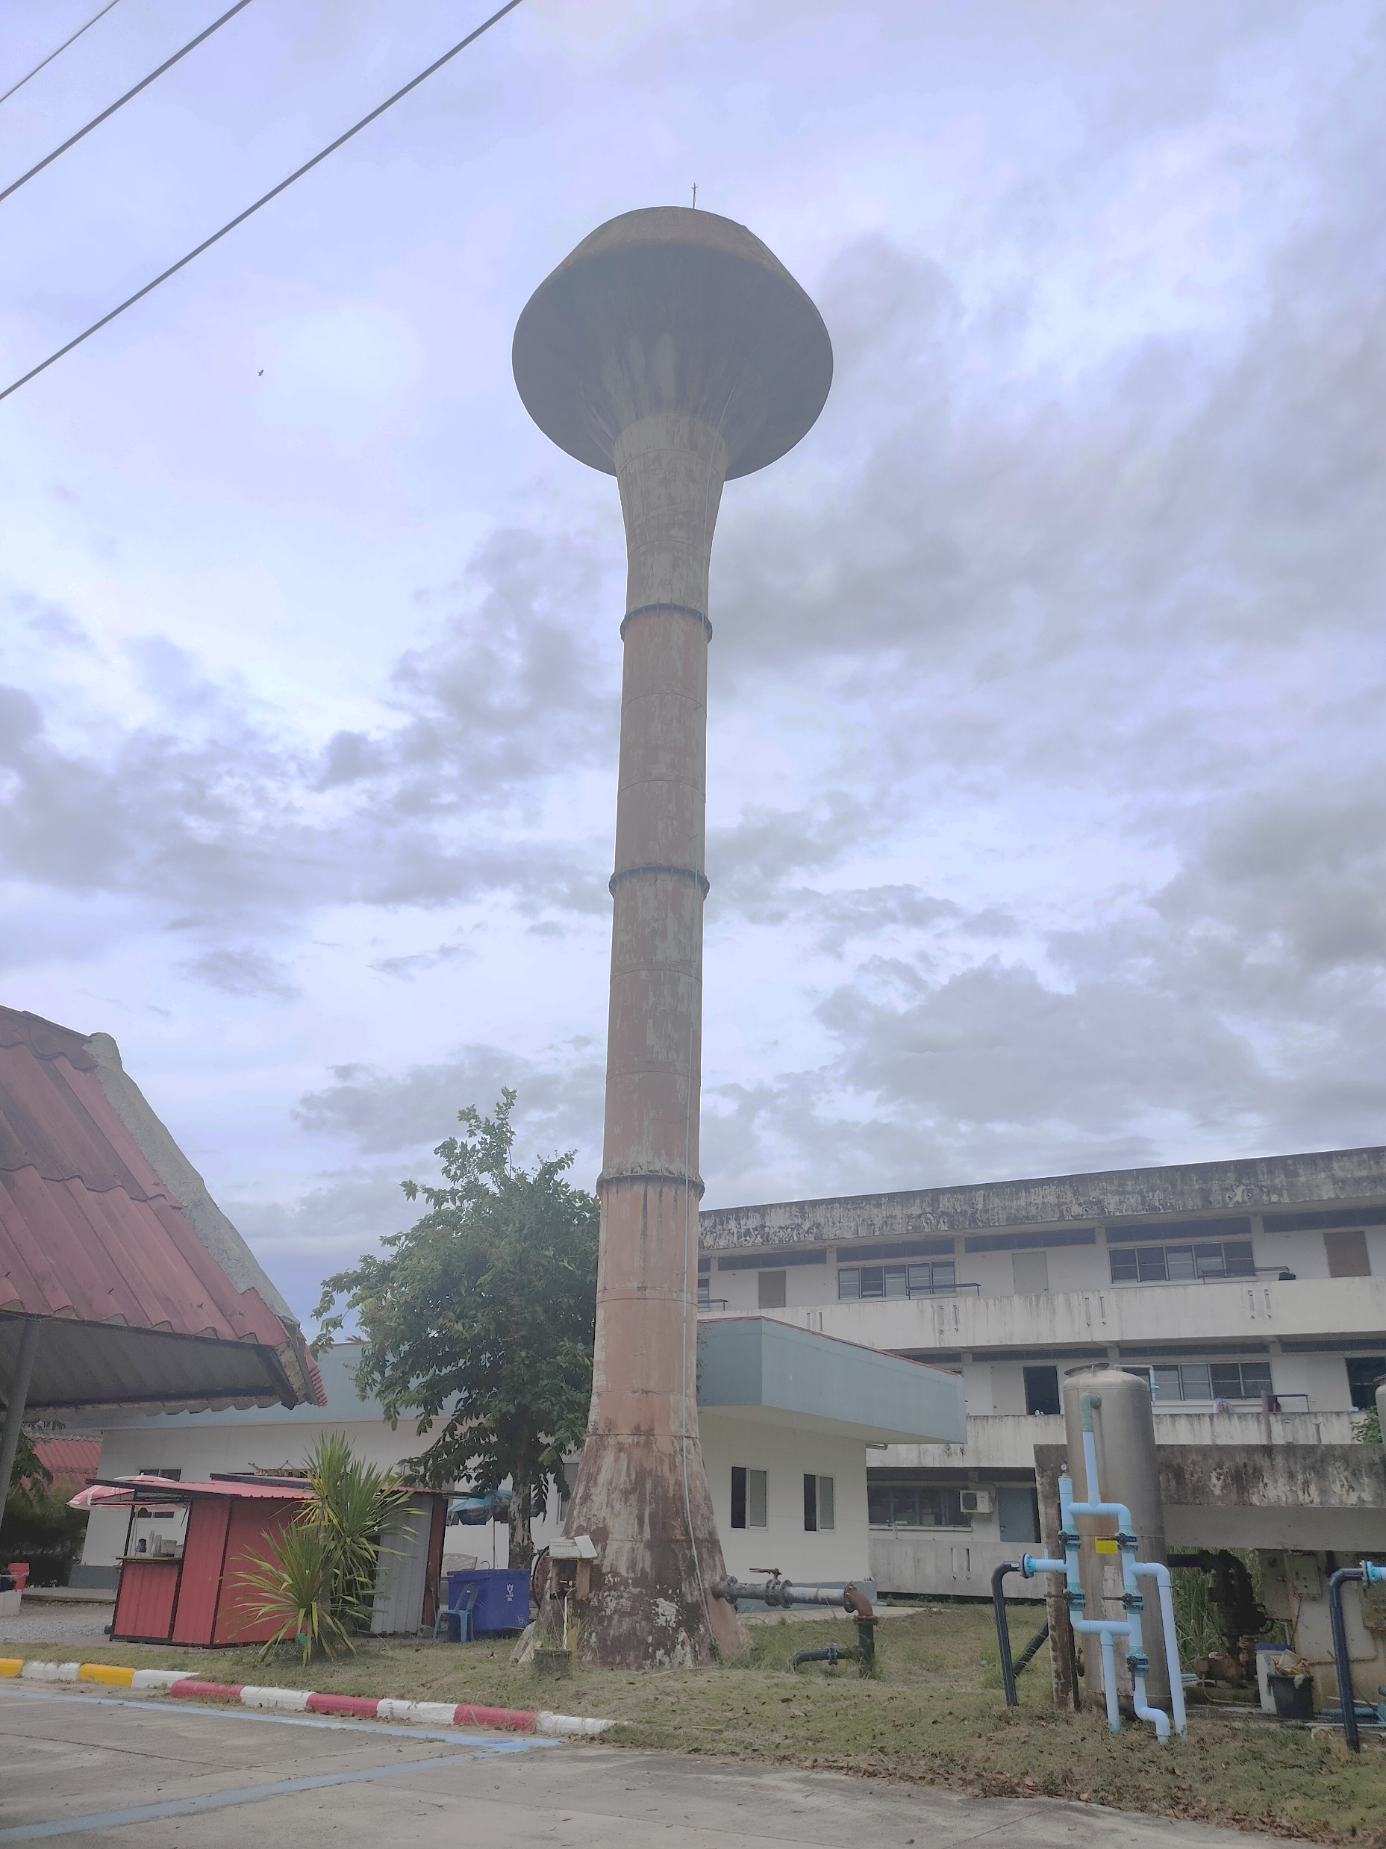
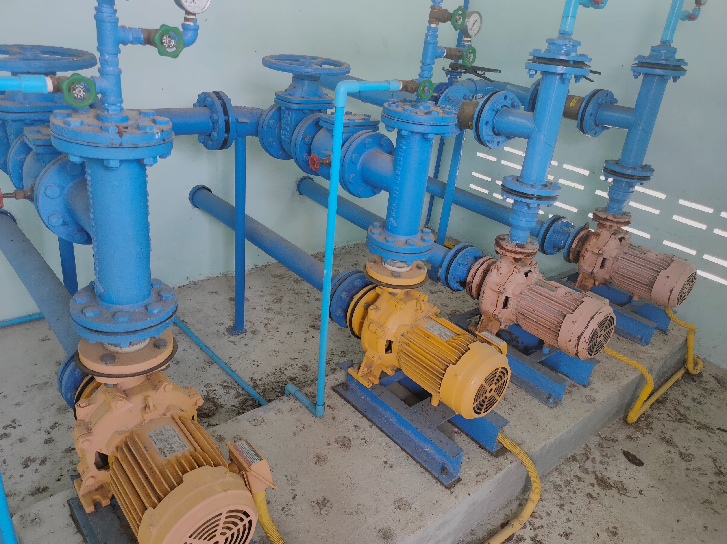
A notification and shutdown system for water pumps using
Internet of Things (IoT) technology.
Notes:
ระบบแจ้งเตือนและตัดการทำงานของปั๊มน้ำโดยใช้เทคโนโลยี IoT

Slide 2

ที่มาและความสำคัญ
Water pumps are important for homes and farms.But if they run without water (Dry Run), they can break and waste electricity.This project helps stop the pump when needed and alerts users to prevent damage.
Notes:
Water pumps are important for homes and farms.But if they run without water (Dry Run), they can break and waste electricity.This project helps stop the pump when needed and alerts users to prevent damage.

Slide 3
Objectives
To develop a notification system that detects and prevents abnormal water pump operations.
To protect water pumps from damage.
To collect various operational data of the water pump.
Scope of Study
The pump must be at least 1 HP
The water pipe must be at least 1 inch
The system uses PZEM-004T, a device that measures electricity usage.
How the system detects problems
Dry Run: The pump is working, but no water is coming out. This may happen if something is blocking the water pipe.
High Electricity Use: If the pump needs too much power, it may be because the motor is stuck and harder to turn.
Notes:
Objectives
To develop a notification system that detects and prevents abnormal water pump operations.
To protect water pumps from damage.
To collect various operational data of the water pump.
Scope of Study
The pump must be at least 1 HP
The water pipe must be at least 1 inch
The system uses PZEM-004T, a device that measures electricity usage.
How the system detects problems
Dry Run: The pump is working, but no water is coming out. This may happen if something is blocking the water pipe.
High Electricity Use: If the pump needs too much power, it may be because the motor is stuck and harder to turn.

Slide 4
Prevents pump damage
The system automatically stops the pump when Dry Run or abnormal power usage is detected.
Reduces maintenance costs
Expected Benefits
Lowers repair costs and reduces the need to replace parts.
Can be used in many sectors
Can be used in households, agriculture, and industries.
Notes:
Expected Benefits
Prevents pump damage by automatically shutting it down when Dry Run or abnormal power use happens, helping it last longer.
Reduces damage to the pump and other equipment, saving repair costs.
Can be used in homes, farms, and industries to make pump use safer and more efficient.

Slide 5
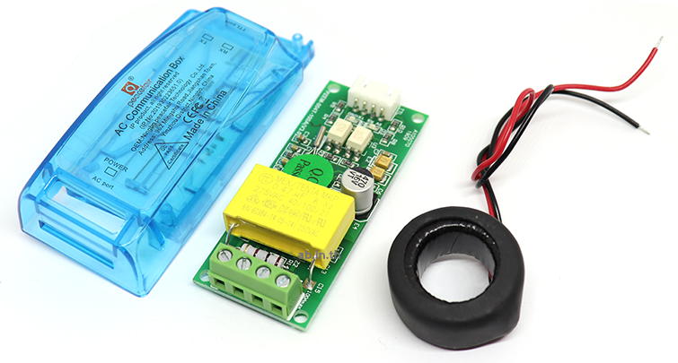
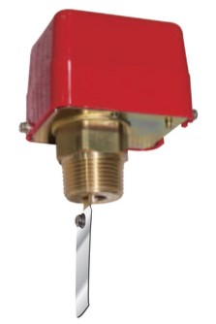
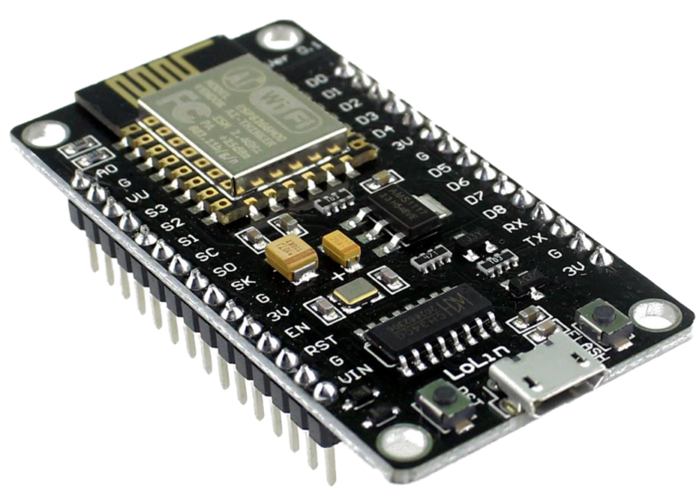
Work Process
Study and Prepare Equipment
Learn how to use and test the Flow Switch, PZEM-004T, and NodeMCU ESP8266.
PZEM-004T
System Design
Design the system to meet the project goals, including both frontend and backend components.
System Performance Evaluation
Test the notification system,Test the automatic shutdown of the pump,Test settings and control via the interface.
Node MCU ESP8266
Flow Switch
Notes:
Work Process
Learn how to use and test devices like Flow Switch, PZEM-004T, and NodeMCU ESP8266 to check their functions and make sure they work properly.
Design the system to match the goal. The Flow Switch checks if water is flowing, PZEM-004T measures electricity use, and a relay helps turn off power. After designing, the system is placed in a plastic box.
Test how well the system works by checking the alert system, automatic pump shutdown, and control settings through the interface.

Slide 6
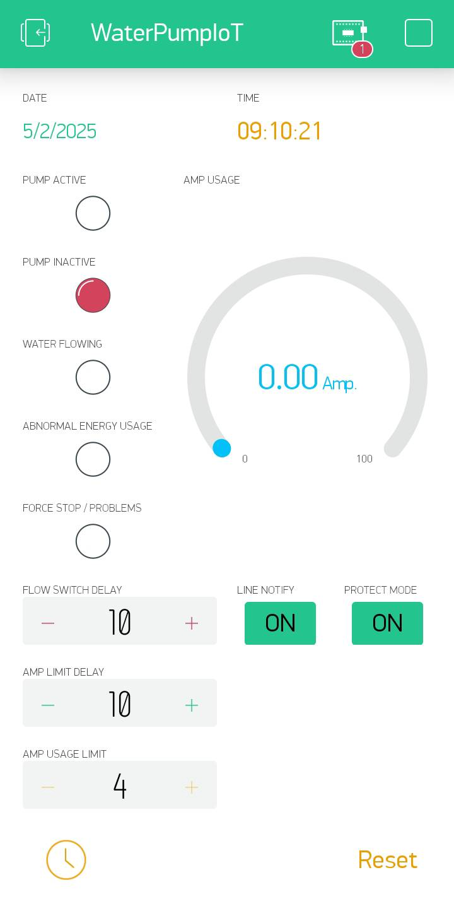
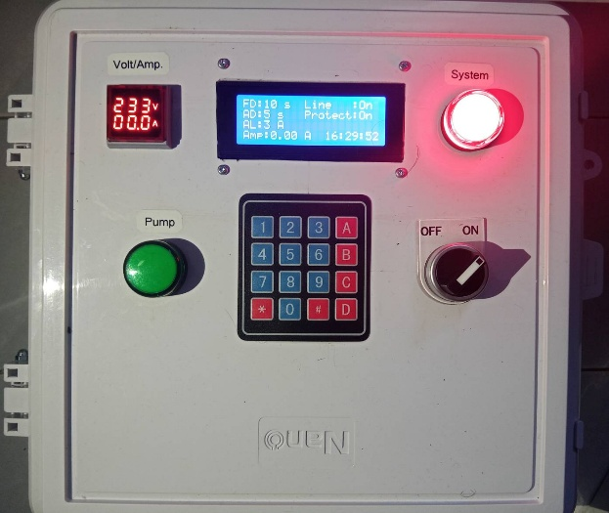
Work Results
Hardware Design
The system uses the ESP8266 board as the main processor. It connects to input devices such as the Flow Switch, PZEM-004T, and 4x4 Keypad. The output device is an LCD 20x4 display.
Front View of the Device
Interface in Blynk
Notes:
Divided into Two Sections
Hardware Design
The system uses the ESP8266 board as the main processor, with the following components:
Flow Switch – Checks if water is flowing.
PZEM-004T – Measures electricity usage.
Keypad 4x4 – Allows users to input settings.
LCD Display – Shows system information.

Slide 7
Work Results
Software Design
The system uses Blynk to display the control interface for the alert and shutdown system. This interface shows the pump status, system status, time, power consumption, and settings.
Interface in Blynk
ภาพด้านหน้าของอุปกรณ์
Notes:
Software Design
The system uses Blynk to display the control panel, which shows the pump status, system status, time, power consumption, and various settings such as power cutoff delay and current limit.
Key Components in the Blynk Interface:
LED indicators (5 units) – Show different system statuses.
Gauge meter – Displays real-time power usage in Amps.
Input fields (3 slots) – Used to set:
Delay for power cutoff when no water flows
Delay for power cutoff when power usage exceeds the set limit
Maximum allowed current
Boolean settings:
Line Notify – Controls whether to send alerts via LINE.
Protect Mode – If turned off, the pump will keep running even if a problem is detected.

Slide 8
ระบบแจ้งเตือนและตัดการทำงานของปั๊มน้ำโดยใช้เทคโนโลยีอินเทอร์เน็ตในทุกสิ่ง
Test Results and Conclusion
The system accurately detects and notifies the pump status via LINE Notify and automatically shuts down in case of Dry Run or excessive power usage.
Testing showed that the system operates stably, reduces pump damage, lowers maintenance costs, and improves water management efficiency.
However, the Flow Switch may be inaccurate in some cases, and an unstable internet connection may cause notification delays, which can be improved in the future.
A notification and shutdown system for water pumps using
Internet of Things (IoT) technology.
คณะผู้จัดทำ
นายธรรมนิตย์ หนูยิ้มซ้าย
นายชยุต สรรพขาว
อาจารย์ที่ปรึกษา
นายฐปนวัฒน์ ชูกลิ่น
Notes:
Test Results and Conclusion
The system performed as designed, successfully detecting Dry Run conditions and abnormal power usage with high efficiency. When an issue occurs, it notifies users via LINE Notify and automatically shuts down the pump, reducing the risk of damage. This helps save on maintenance costs and prevents unnecessary electricity consumption.
Additionally, the system allows users to adjust delay settings and power limits conveniently through the Blynk app.
However, some minor issues were found, including Flow Switch inaccuracy in certain cases and internet instability, which may cause notification delays. These issues can be improved in the future by using ultrasonic Flow Sensors or developing a data logging system for offline use when the internet is unavailable.

Slide 9
A notification and shutdown system for water pumps using
Internet of Things (IoT) technology.
Project Team
Mr. Thammanit Nuyimsai
Mr. Chayut Sappakhao
Project Advisor
Mr. Thapanawat Chuklin
Notes:
This concludes our presentation. If the committee has any questions or concerns, we are happy to listen and provide answers.

